Slide 1

Text to speech using IBM watson

Slide 2
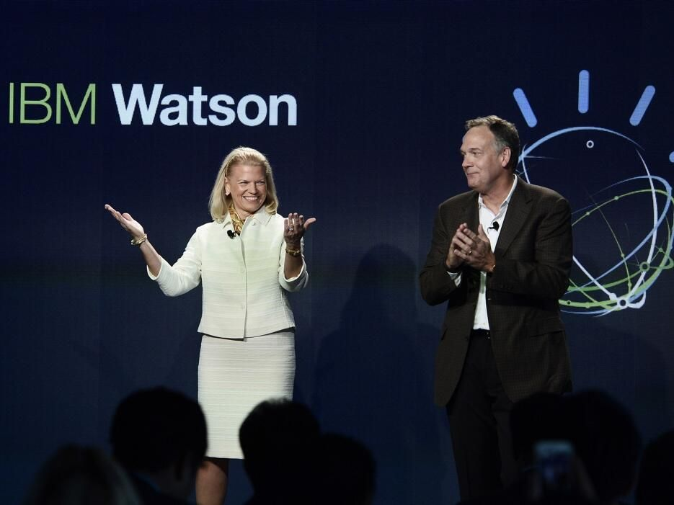
Here we are gonna see how IBM watson ’s AI solves customer issues the first time, across any channel

Slide 3
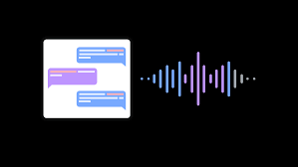
IBM Watson Text to Speech is an API cloud service that enables you to convert written text into natural-sounding audio in a variety of languages and voices

Slide 4

Why IBM watson ?
The Lite plan gets you started with 10,000 characters voice per month at no cost.

Slide 5
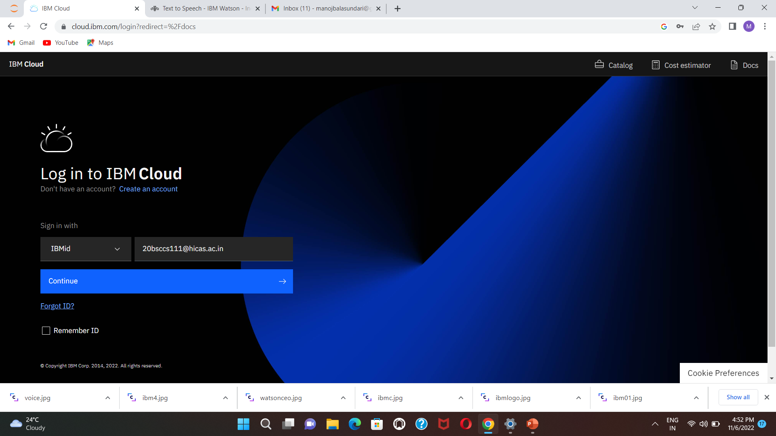
Getting started
Log in IBM Cloud using your account open Text to Speech Service
resource.

Slide 6
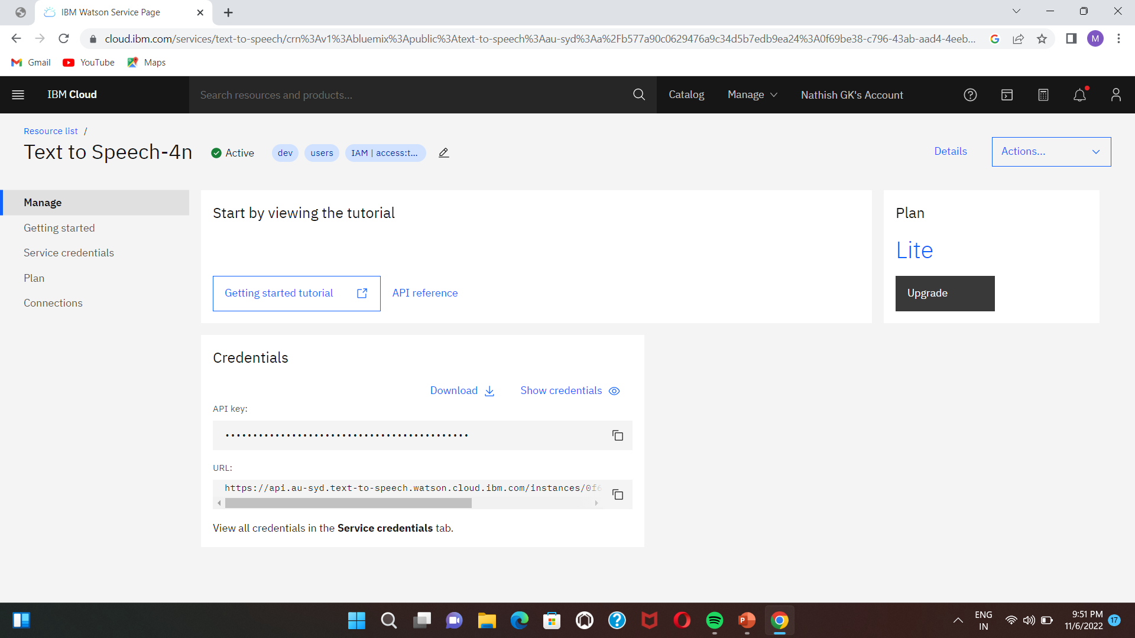
It’s redirected to the service page, and there you will find the credentials
( API key and URL ). Copy them for later use.

Slide 7
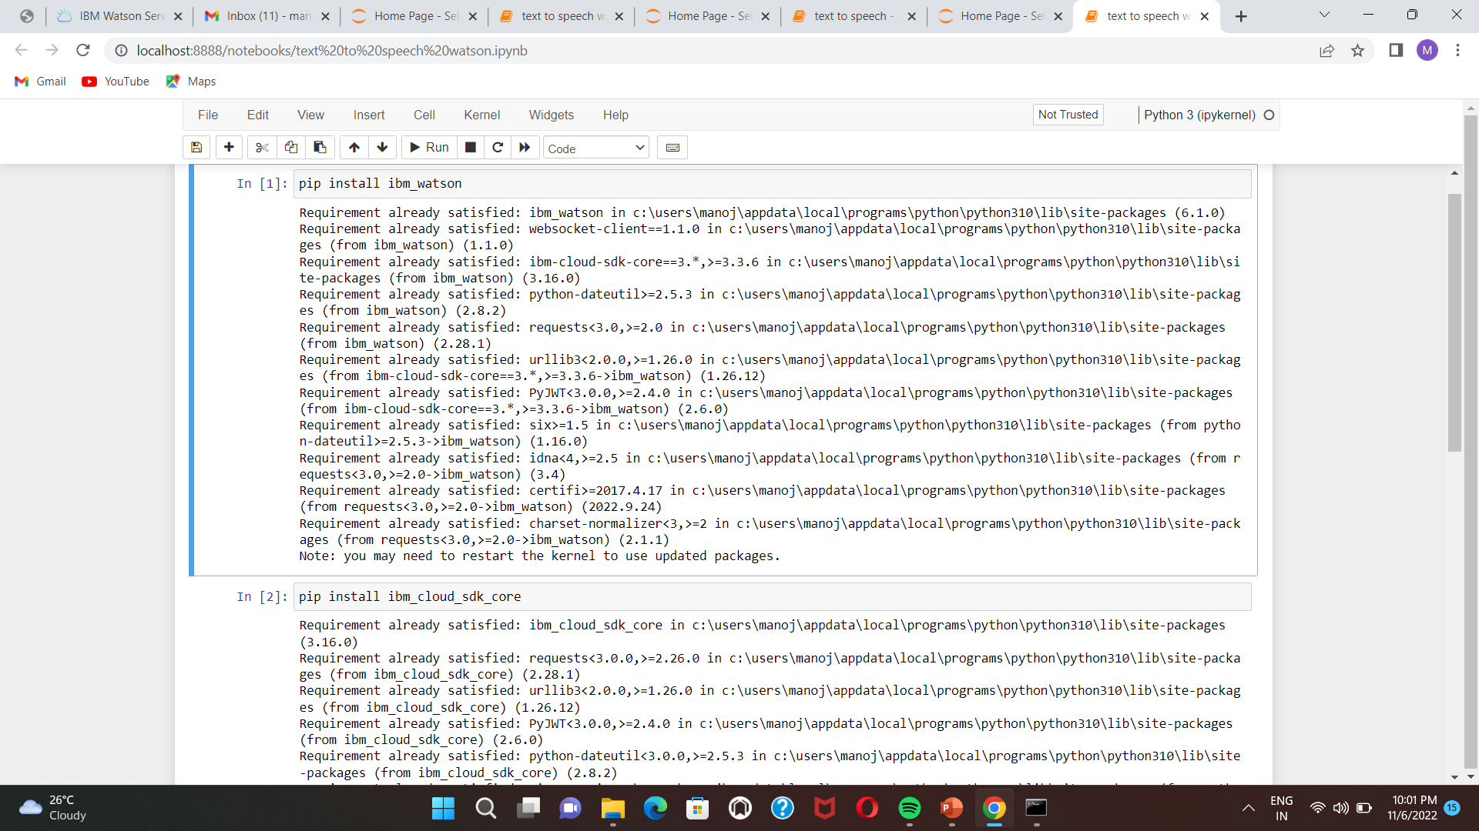
Open Jupyter Notebook to implement a few lines of code in python to
authenticate our model

Slide 8
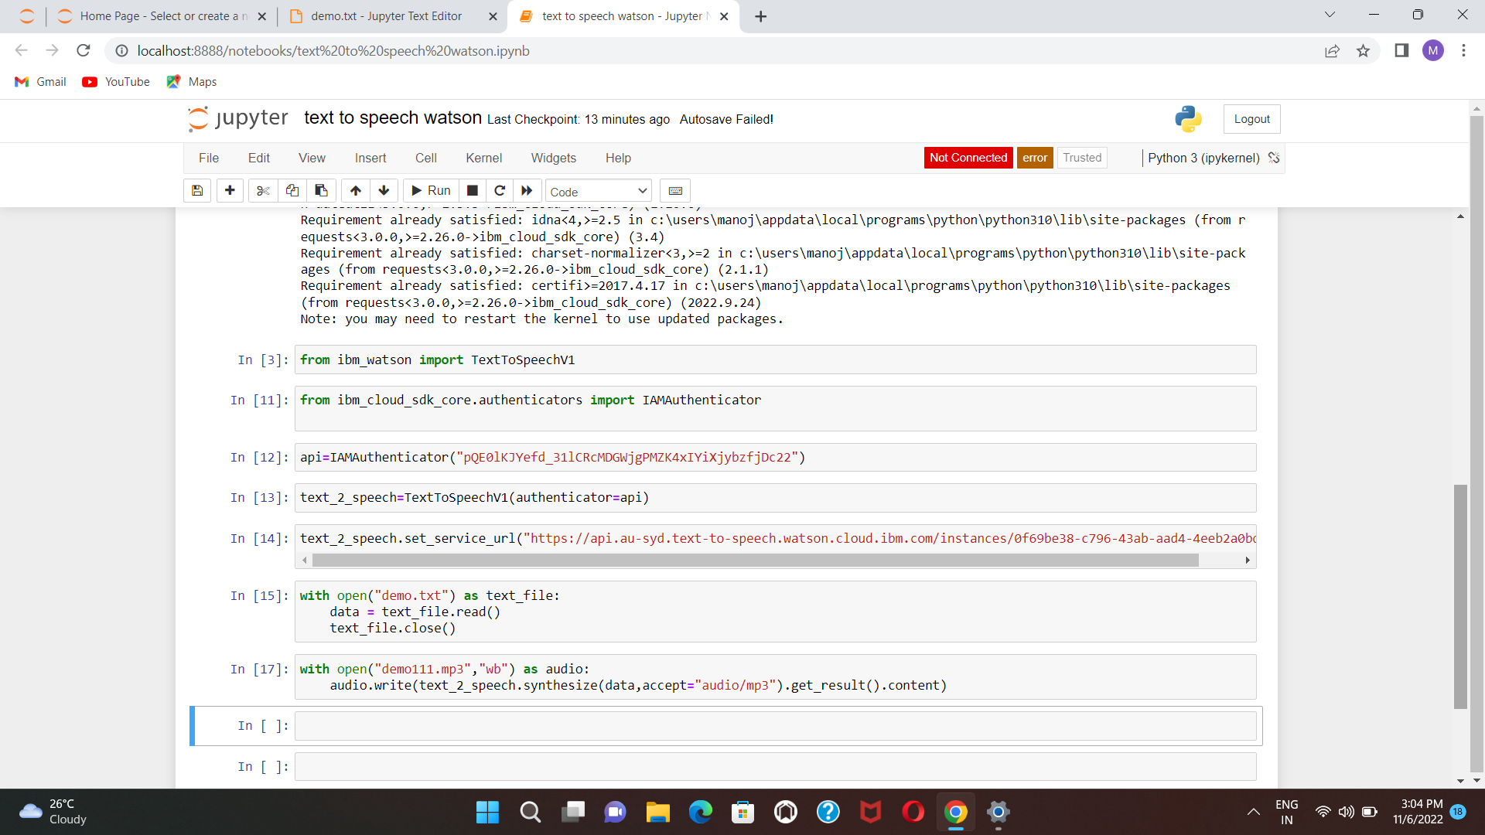
type the text to speech python code now paste text to
speech service API key and URL and run the model

Slide 9
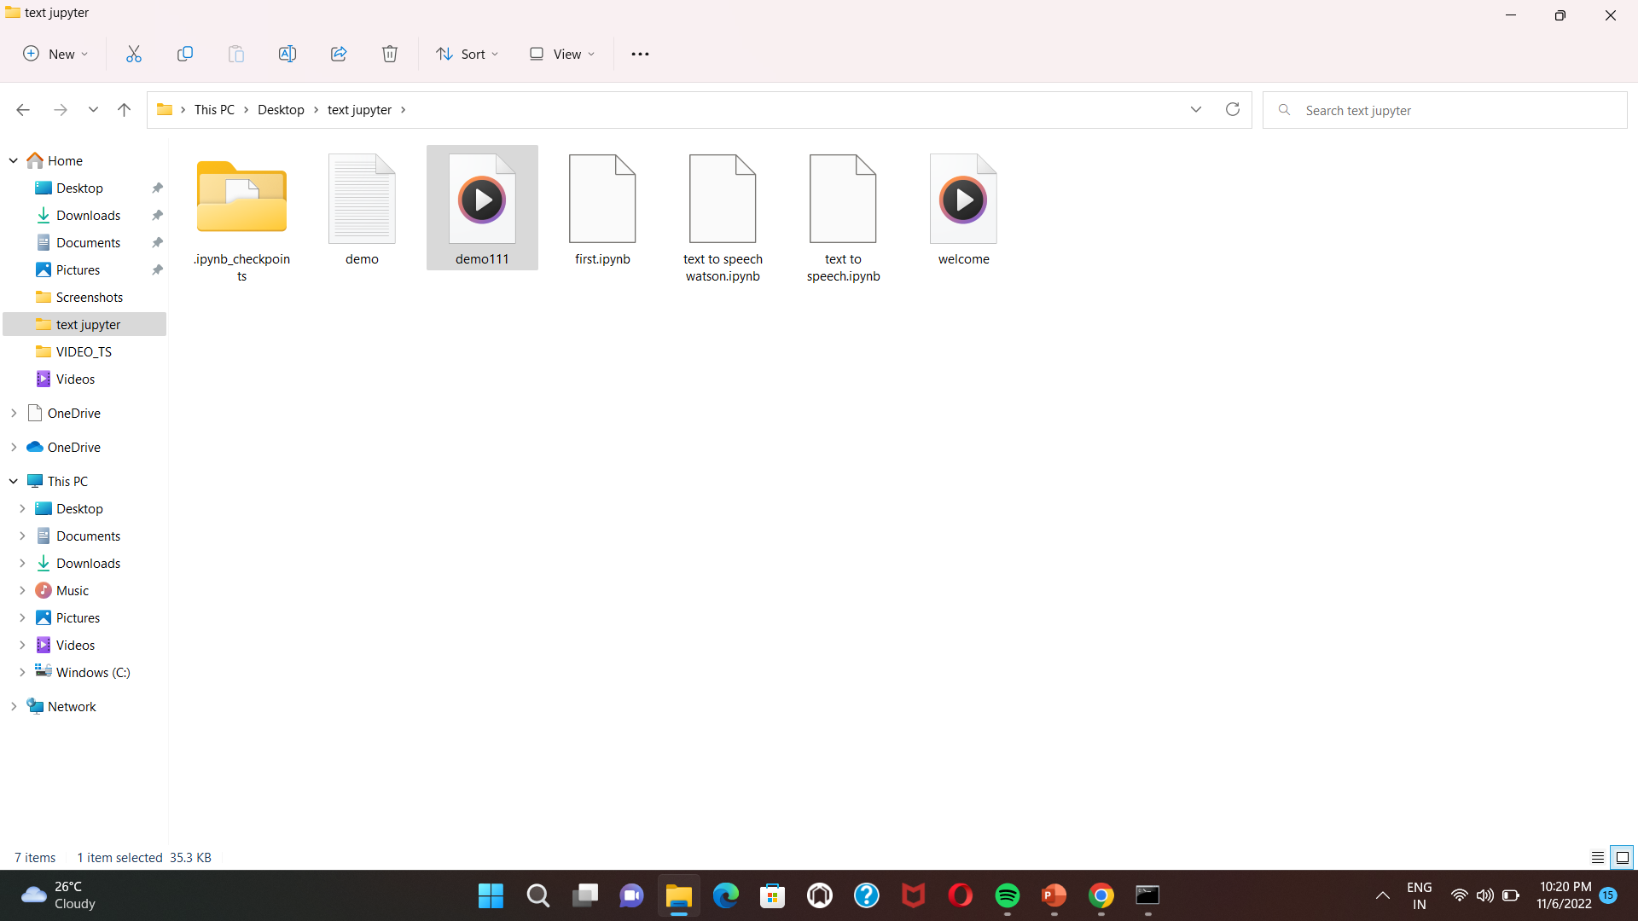
Now your input text will be converted to audio file.

Slide 10
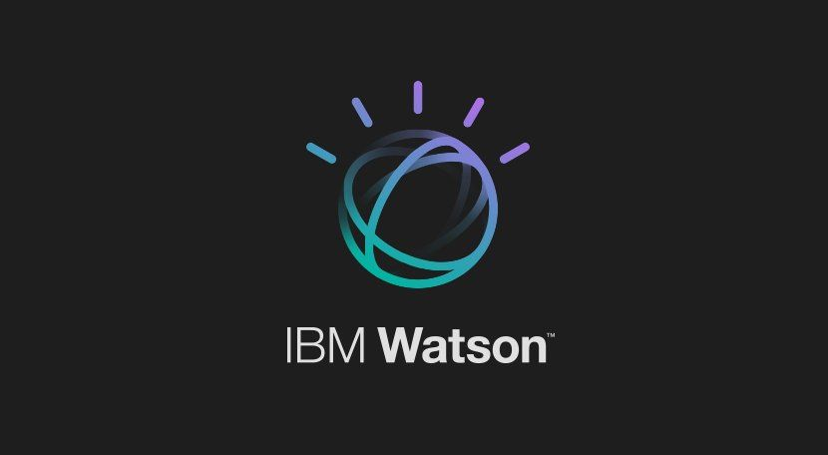
This is how text to speech using IBM Watson works…

